Slide 1
A Seminar on IOT Based Solar Power Monitoring System
Team Details
M SRIRAM – 20EG105714
K HARSHAVARDAN– 20EG105703
G MOKSHITHA– 20EG105116
K. ARYAN– 20EG105126
Project Supervisor
V. JYOTHI
ASSISTANT PROFESSOR

Slide 2
Introduction
In this project, we have made a simple solar monitoring system by using an ESP32 development board, where the solar panels are used for producing electricity, with the help of sunlight.
The aim is to design solar energy monitoring and share information through IoT. It consists of a charge controller with an ESP32 module, a voltage sensor, and a current sensor. When the ESP32 module is a controller integrated with Wi-Fi and Bluetooth support, where the sensor checks the conditions that are programmed and detects the output voltage and current.

Slide 3
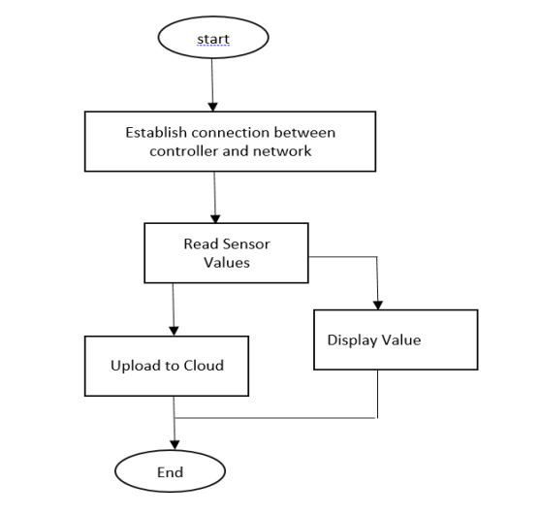
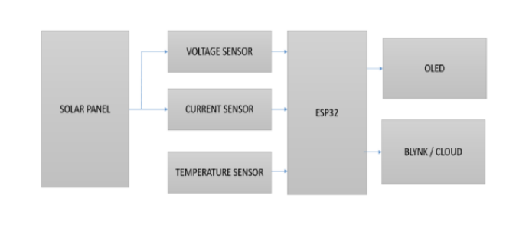
Concept Tree

Slide 4
Literature
SL No | Author (s) | Method | Advantages | Disadvantages
1 | HUGO T.C. PEDRO, EDWIN LIM, CARLOS F.M. COIMBRA | A database infrastructure to implement real-time solar and wind power generation intra-hour forecasts | 1. Improved Grid Stability 2. Optimized Power Trading 3. Enhanced Asset Management | 1. Data Quality and Availability 2. Model Complexity and Accuracy 3. Computational Resources
2 | AMIT KUMAR ROHIT, AMIT TOMAR, ANURAG KUMAR, SAROJ RANGNEKAR | Virtual lab-based real time data acquisition, measurement and monitoring platform for solar photovoltaic module | 1.Reproducible experiments. 2. Safe and controlled. 3. Cost-effective 4. Customization | Limited realism Hardware limitations Software expertise Data validation

Slide 5
Literature(cont..)
Sl No | Author(s) | Method | Advantages | Disadvantages
3 | N.A. OTHMAN, N.S. DAMANHURI, I.R. IBRAHIM, R. RADZALI, M.N. MOHD | Automated Monitoring System for Small Scale Dual-Tariff Solar PV plant in UiTM Pulau Pinang | 1. Improved Performance Monitoring 2. Early Fault Detection 3. Enhanced Data Analysis 4. Remote Access and Control | 1. Initial Investment Cost 2. Cybersecurity Risks 3. System Complexity

Slide 6
Problem Statement
In the realm of solar power monitoring, traditional systems often fall short in providing real-time insights and proactive management. Existing solar power systems, especially small-scale installations, typically lack real-time monitoring, automation, and optimization capabilities. This results in:
Inefficient energy generation: Due to limited understanding of power output fluctuations and environmental factors, potential energy production might not be fully utilized.
Reactive maintenance: Untimely detection of faults or performance issues leads to delayed repairs and lost energy production.
Manual control: Time-consuming and inefficient manual adjustments to optimize energy usage based on changing demands and grid conditions.
Limited data for decision-making: Lack of comprehensive data hinders informed decisions about system upgrades, expansion, and energy consumption patterns.

Slide 7
Problem Illustration
Imagine a small rooftop solar system on a residential building. It experiences inconsistent power output due to shading or weather variations, but the homeowner is unaware until they receive their energy bill. Additionally, potential inverter malfunctions go unnoticed until causing a complete system shutdown. Manually adjusting energy consumption based on daily needs is tedious and often ineffective

Slide 8
Proposed Method
The envisioned approach centers around the deployment of Internet of Things (IoT) devices integrated with an array of sensors meticulously positioned to capture and monitor essential parameters associated with solar power generation. These parameters encompass voltage, current, temperature, and sunlight intensity.
The data collected in real-time by these sensors is then transmitted wirelessly to a designated central server.

Slide 9
Proposed Method Illustration
1. Sensor Deployment: Strategically place sensors on solar panels to capture and measure critical parameters including voltage, current, temperature, and sunlight intensity.
2. IOT Devices: Connect these sensors to IoT devices, such as microcontrollers, capable of processing and transmitting the collected data.
3. Data Transmission: Utilize wireless communication protocols such as MQTT or HTTP to establish a seamless flow of data from IoT devices to a central server.

Slide 10
Proposed Method Illustration
4. Central Server: Establish a dedicated server to receive, store, and process the incoming data. This server serves as the central hub for monitoring and managing the solar power system.
5. Data Analysis: Implement sophisticated algorithms to analyze the collected data, extracting insights into energy production, system efficiency, and environmental conditions.
6. User Interface: Develop a user-friendly interface, either in the form of a web application or mobile app, enabling users to monitor the solar power system in real-time. This interface should also facilitate historical data analysis and provide timely notifications.

Slide 11
Parameter
1. Energy Production: E = P * t
where P is the power generated and t is the time.
2. Efficiency (η): η= (Actual Power Output / Maximum Possible Power Output) *100 %.
3. Temperature Correction Factor (TCF): TCF = 1 + 0.005 * (T - 25)
where T is the temperature in degrees Celsius.
4. Performance Ratio (PR): PR = (Actual Output Energy / Expected Output Energy) * 100 %.

Slide 12
Experiment Environment
1. Integration with IoT platforms like Thingspeak Server for real-time monitoring and logging of parameters
2. Ardino UNO
3. Things Speak Server
Hardware Components:
1. Arduino or ESP32 microcontroller
2. Solar panel.
3. WiFi module for internet connectivity.
4. Voltage and current sensors for monitoring power output.
5. LCD display for real-time parameter display.
6. Other components like resistors, capacitors, transistors, cables, connectors, diodes, PCB, and breadboards

Slide 13
Project status
S.No | Functionality | Status (Completed /in-progress/Not started)
1 | Resources and learning | In- Progress
2 | Things Speak Server | In- Progress
3 | Source Code | In-Progress
4 | Integration of Components | Not Started
5 | Applying algorithms to the project | Not Started

Slide 14
References
[1] Hugo T.C. Pedro, Edwin Lim, Carlos F.M. Coimbra(2018), “A database infrastructure to implement real-time solar and wind power generation intra-hour forecasts”, International Journal of Renewable energy Elsevier
[2] Amit Kumar Rohit, Amit Tomar, Anurag Kumar, Saroj Rangnekar(2017), “Virtual lab-based realtime data acquisition, measurement and monitoring platform for solar photovoltaic module", International Journal of Resource-Efficient Technologies
[3] N.A. Othman, N.S. Damanhuri, I.R. Ibrahim, R. Radzali, M.N. Mohd (2010), “Automated Monitoring System for Small Scale Dual-Tariff Solar PV plant in UiTM Pulau Pinang", Proceedings of the World Congress on Engineering(WCE) U.K

Slide 15
Thank you

